Slide 1
Ubi Art Framework
David Punset
Frederic condolo
Rayman Origins
Montpellier
Rayman Origins
Montpellier

Slide 2

UBIart
Open FrameWork
Everyone Creates Everything
Ubi-art.com

Slide 3
Table of Contents
Global Architecture
Serialization
LUA usage
The frieze system
The patch system
The game logic system

Slide 4
GLOBAL ARCHITECTURE

Slide 5
Some figures
200 000 lines of code
Full rebuild takes 2-3 minutes
3 to 5 seconds to link
More than 50 projets
Ported to PC / X360 / PS3 / IPAD /Wii / 3DS

Slide 6
Programming team
11 people:
  Edition / Tools : 3 juniors, 1 senior
  Core engine/ consoles : 3 seniors
  GPP : 1 junior, 3 seniors

Slide 7
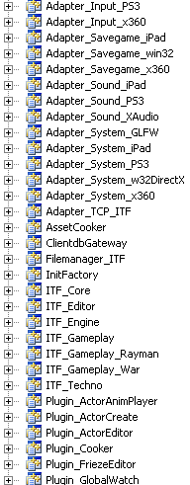
Premake
Gracefully handling 50+ projects & 6 target plateforms
No projet stored on Perforce
Projects are re-generated everytime we sync

Slide 8
Premake example
ITF_setproject( "../src/core/","c+","StaticLib")
ITF_filelist(sourceroot ,"**.cpp")
ITF_filelist(sourceroot,"**.h" )
ITF_includepaths({"$SolutionDir)../../src"})
ITF_excludefrombuild( {"Debug","Release","Final"},{"PS3","Xbox360"},
{"StackWalker.cpp"})

Slide 9
High level architecture
ADAPTERS
ENGINE
GAMES | PLUGINS
EXTERNAL TOOLS
Hot reloading
TCP/IP

Slide 10
Edition message example
Adapter_Input_DirectInput (implements InputAdapter)
User clicked mouse at coord x,y
Editor (picking module)
Actor picked
Plugin_Gateway
Forward to all connected plugins
Plugin_ActorEditor
Serialization system
Properties Editor
Scene Explorer
TCP/IP
Sequence Editor
Actor Editor

Slide 11
SERIALIZATION

Slide 12
Unique generic serialization
Tools
Undo / Redo
Serialization
Serialization
Serialization
Serialization
Binarization
Load / Save
Import / export
Cloning

Slide 13
Unique Implementation
IMPLEMENT_OBJECT_RTTI(AnimatedComponent)
BEGIN_SERIALIZATION_CHILD(AnimatedComponent)
SERIALIZE_FUNCTION(clear, Init_Load|Clone_Load);
SERIALIZE_MEMBER("textureFile",m_textureFile,...);
SERIALIZE_CONTAINER_OBJECT("actions",m_actionsList, ...)
END_SERIALIZATION()

Slide 14
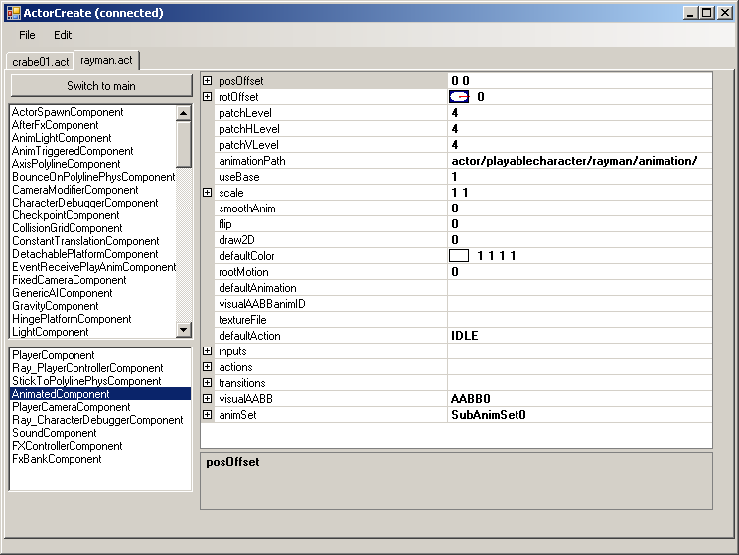
Utilisation du LUA

Slide 15
LUA USAGE

Slide 16
LUA USAGE
Game Script
Ais / Behaviors

Slide 17
LUA Usage
Game Script
Ais / Behaviors
DATA!
Used as XML, but more flexible and more readable

Slide 18
LUA Usage
Actor
settings
LUA
Enemy
settings
LUA
Hunter
settings
LUA
Function call
=
Data inheritance!

Slide 19
LUA Usage
WindComponent = {
force=vector2dNew(-60.0,0.0),
Type = 1,
point=0,
inverted=0,
gradientPercentage=0.5,
Box = {
BoxData = {
width=12.0,
height=8.0, }}}

Slide 20
LUA Usage
Automatic binarization (logic database)
Hot reloading
LUA interpreter excluded from FINAL build

Slide 21
FRIEZES

Slide 22
Friezes - Goals
Automatically performs a part of artists job
Allows LDs to adjust terrain (collisions) with no need for an artist to rework visuals
Allows fast and easy creation of grounds and backgrounds

Slide 23
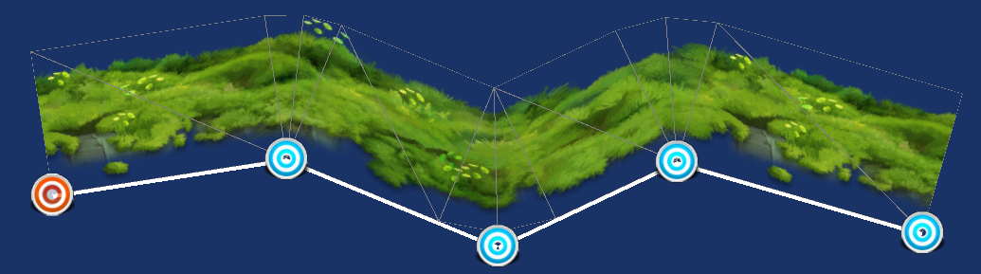
Skeleton creation

Slide 24
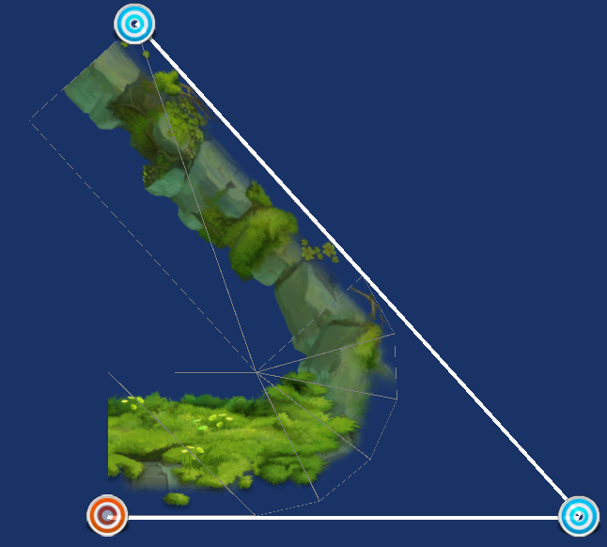
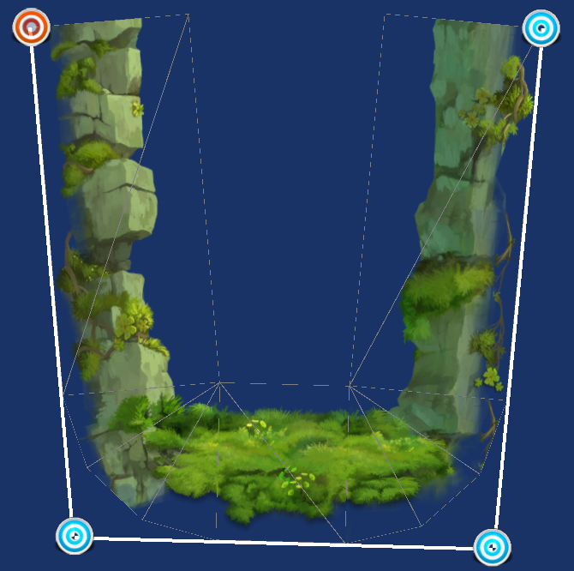

Slide 25
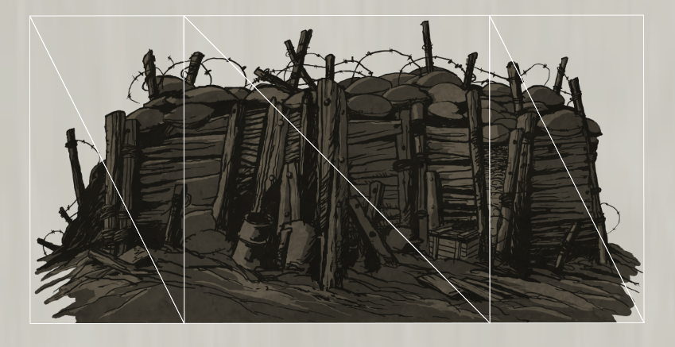
Simple UV system

Slide 26
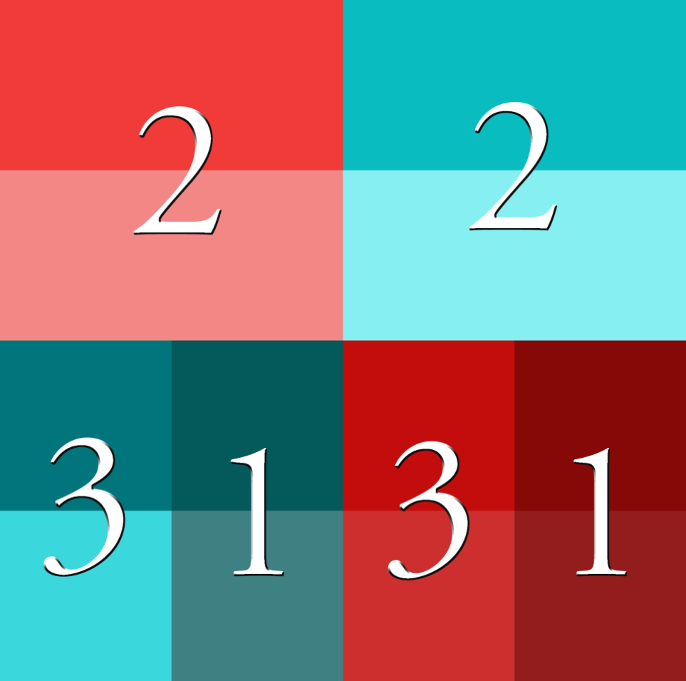
Simple UV system

Slide 27
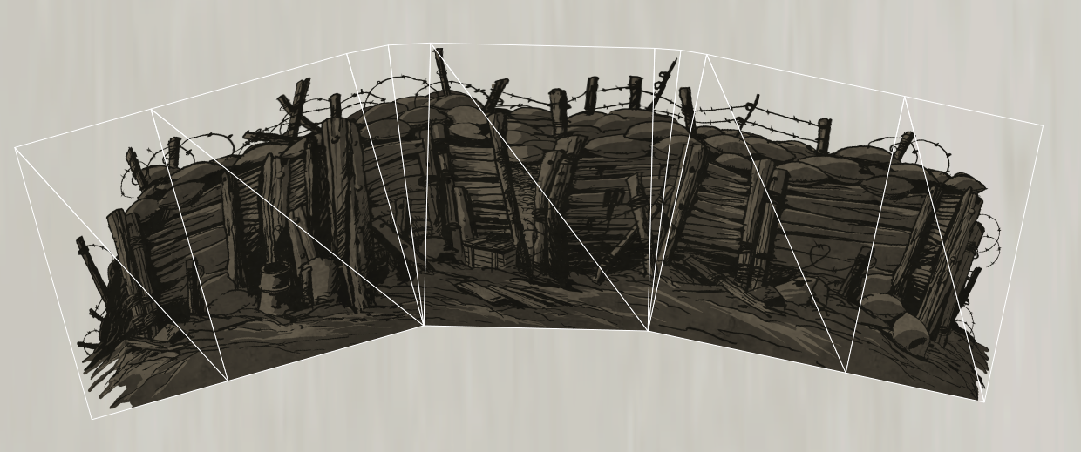
Simple UV : Geometry

Slide 28
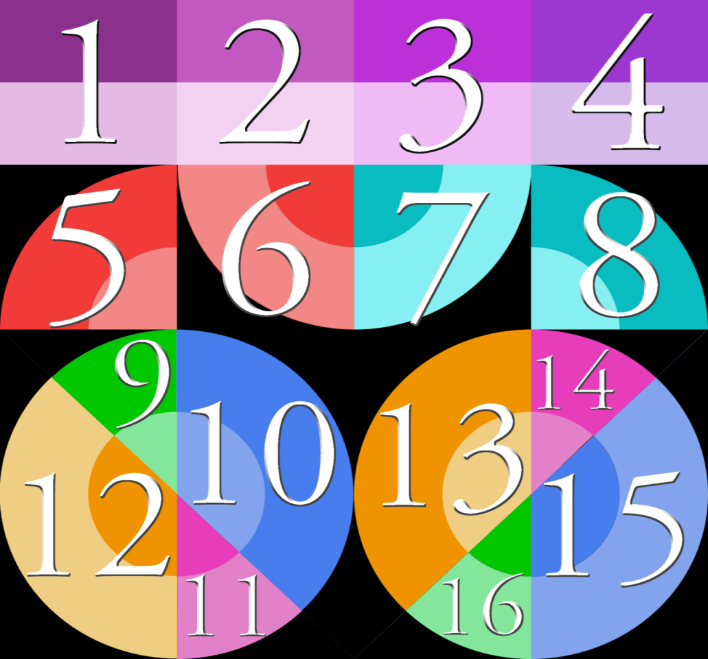
Complex UV system

Slide 29
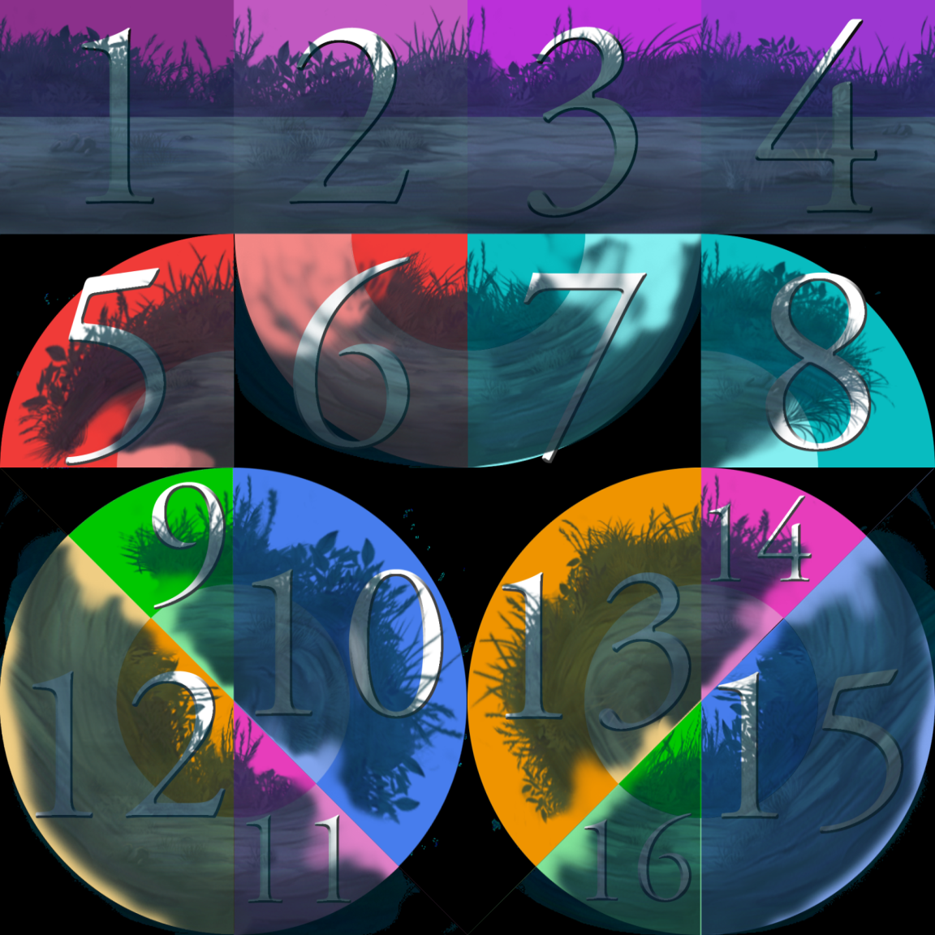

Slide 30
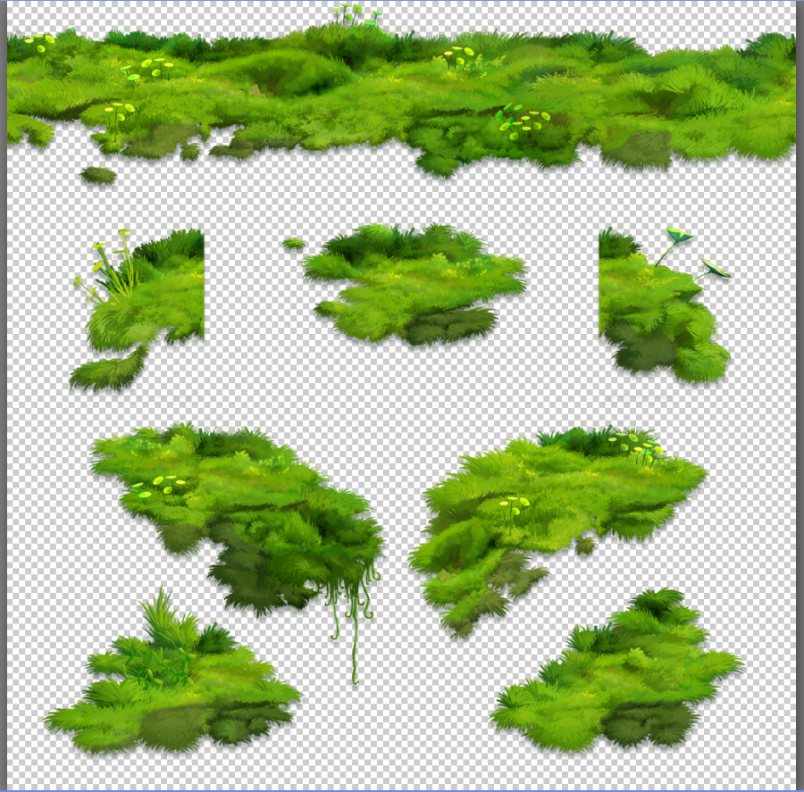
Choix des UV

Slide 31
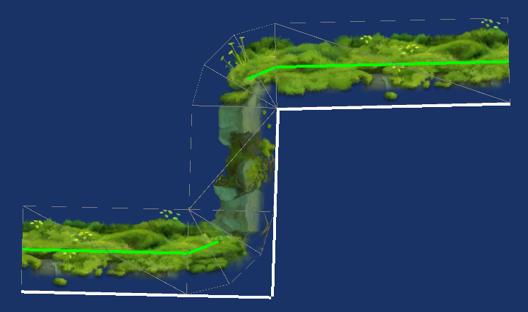
Complex UV system

Slide 32
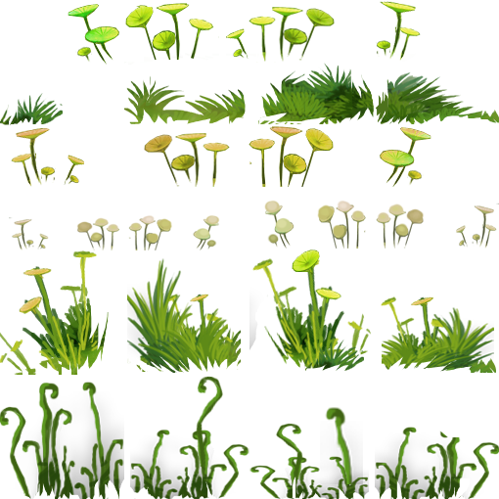
Overlays

Slide 33
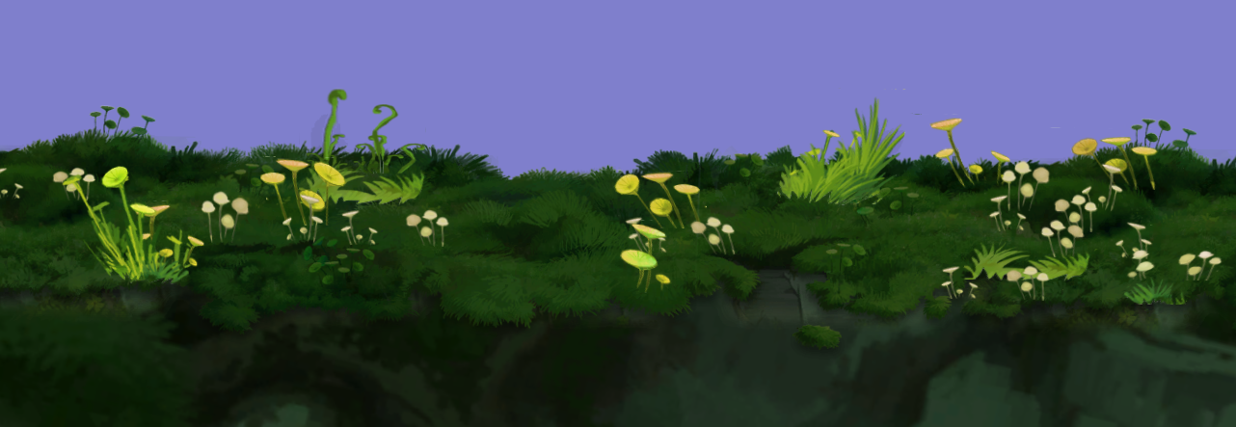
Overlays

Slide 34
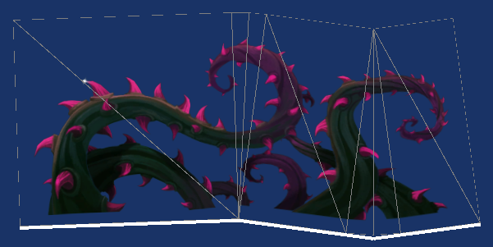
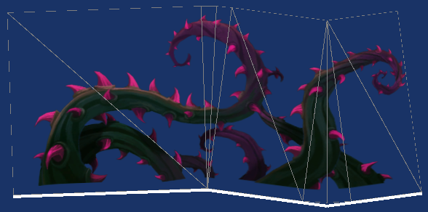
Animation

Slide 35
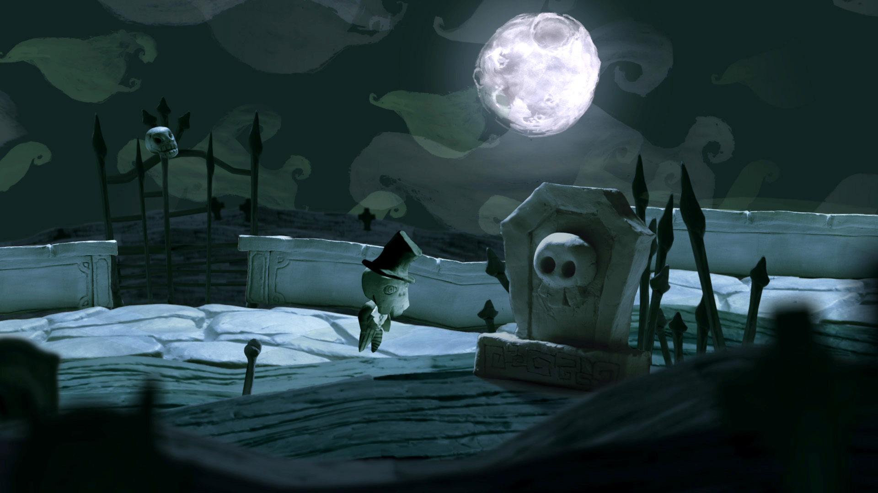
Friezes combination

Slide 36
PATCH OBJECTS

Slide 37
Patch Objects
Classical Skeleton / Mesh system
The same mesh is shared for all objects with identical precision
A vertex shader deforms meshes according to bones
Bones and bones influence uppon nurbs control points is done by the CPU (jobs)

Slide 38
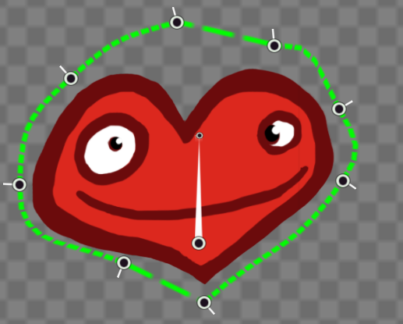

Slide 39
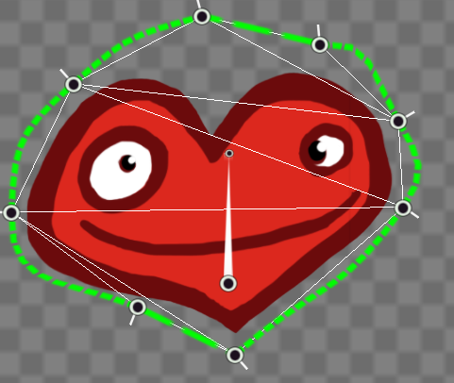
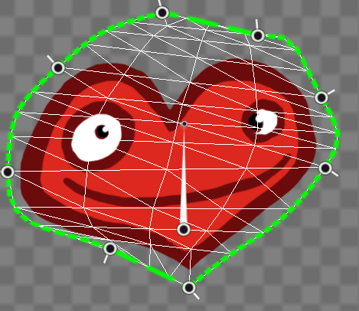
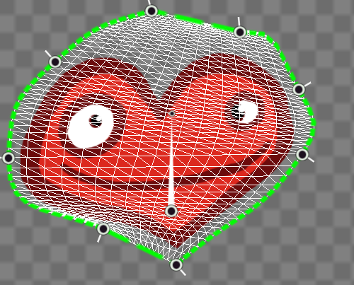

Slide 40
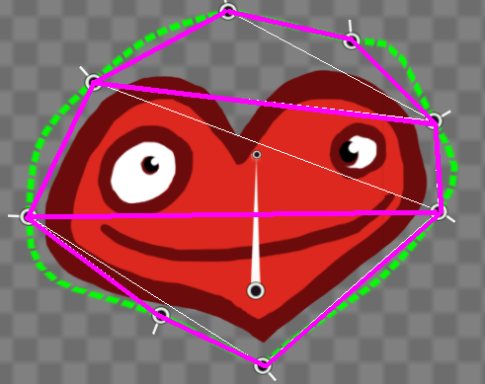
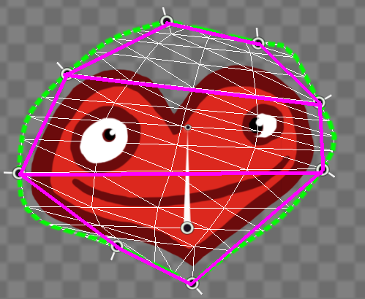
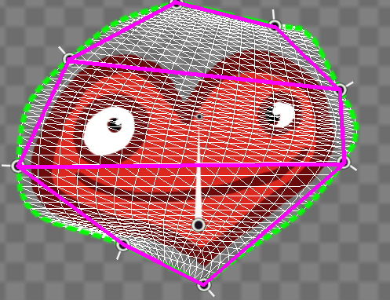

Slide 41
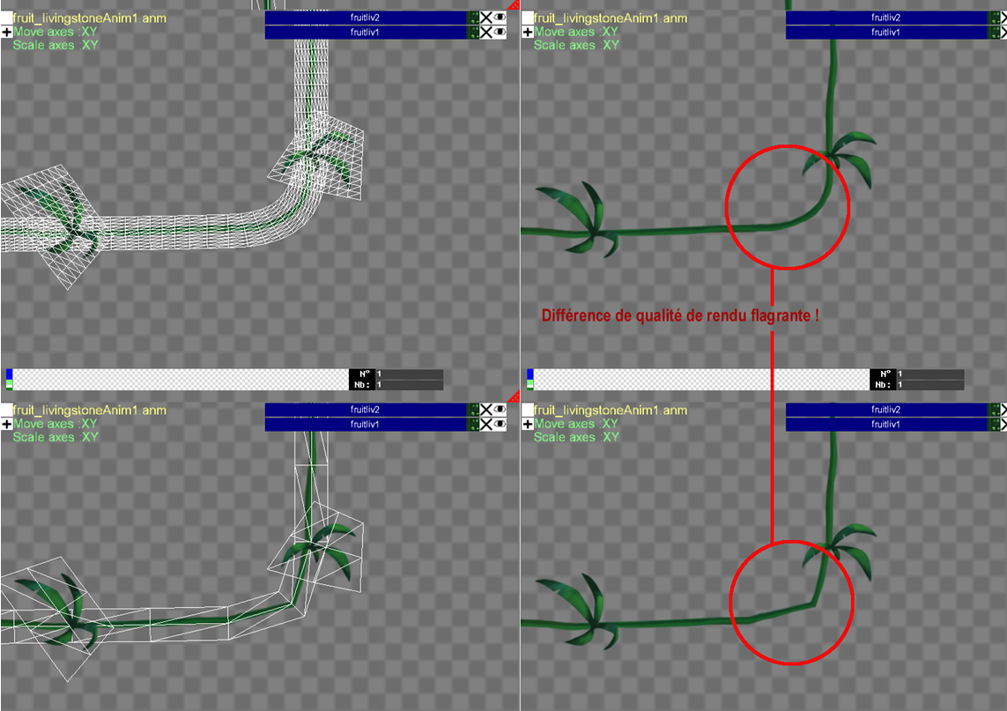

Slide 42
The worlds
A world is a Scene, which can contain instances of other Scenes.
A Scene contains Actors and Friezes.
  Actor: logic entity with a behavior.
  Frieze: environment data.
Scenes can be instantiated multiple times within a world, and it’s possible to stablish a reference between actors from scene to scene.

Slide 43
World structure graphic
Pictures of scene instancing.
Explain the advantages of this feature.

Slide 44
Game logic
The game logic is driven by Actors.
Actors are entities placed inside a scene, which contain one or more components.
Components are created through factories, allowing game-specific component creation.
Components implement your game.

Slide 45
Actor components
We differentiate between two type of components:
  Independent: reusable and without dependencies on other components. For example: graphic components, physics, triggers, etc…
  Controllers or AI: they act as directors of the independent components. They are implemented specifically for certain actors and act on the core components directly. For example: player controller, artificial intelligence, sound controller, etc…

Slide 46
Animation integration
We provide two components to animate an actor:
  Anim Light: consists of an animation on a loop. Most lightweight animation support.
  Animated: chooses what animation to play from an animation tree.
  We will come back to this in a couple of slides.

Slide 47
Blend Tree
The blend tree is a generic template class that can be derived to implement animation trees, cameras, sound, etc…
The basic principle is: it receives a list of input values and it returns the resulting blending.
The specialization requires implementing:
  The leaf node (play animation, play sound, camera data, etc…)
  The data structure to blend and how to blend it.
It provides a list of basic blending nodes (blend by weight, select active child, additive, etc…)

Slide 48
It allows implementing your own nodes if necessary for game-specific needs.
It’s completely game independent and data driven. Data is fed when the game updates, then the blend tree result is computed based on the values, so it’s easy to parallelize.
It supports defining transitions between different nodes.
A simple tool can be used to test the results.

Slide 49
Animation Tree
Characters in Rayman are animated with animation trees.
Each character state contains its own subtree (idle, jump, fall, punch, etc…). This keeps the size of the current animation tree small and makes it easier to work with.
The Rayman character pushes the limit, using more than 400 animations integrated in his own animation tree.

