Slide 1
UAF - events

Slide 2
Overview
Events - official inter-Actor communication tool
Events executed immediately when raised (not thread safe and no posting of events)
UA_EventsTracker as a debugging tool for events

Slide 3
How it works
Listener
  A class which wants to listen for events inherits IEventListener interface
  Registers itself to one of EventBroadcasters for specific Event type when it wants to start receiving events
Sender
  A class which wants to raise events, needs to know (or be) an EventBroadcaster which will serve as relay for event broadcasting
  To raise an event, a sender calls EventBroadcaster::broadcastEvent()

Slide 4
In practice
Notable event broadcasters:
  Actor
  EventManager
  some JD specific classes (HUDManager, TimelineManager, etc.)
Actor components will use their actor to send events
Actor will send events to linked actors (via LinkComponent)
EventManager can be considered a generic event hub

Slide 5
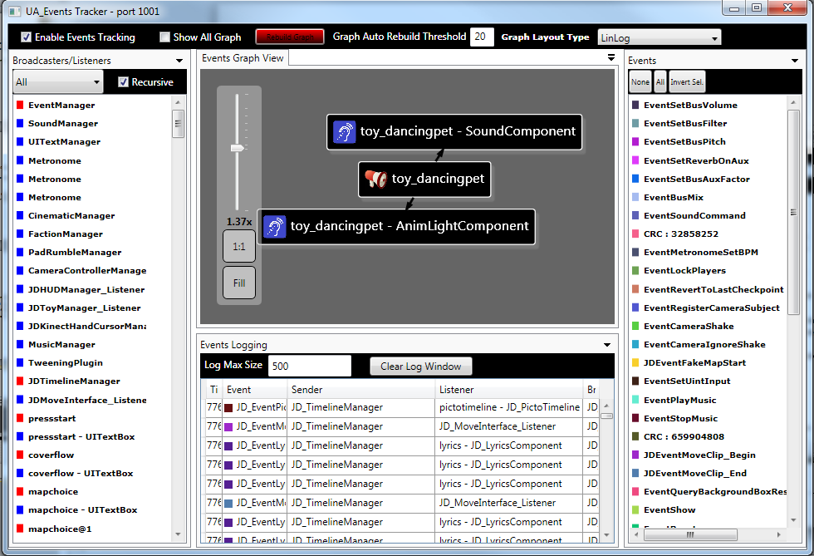
EventsTracker

