Slide 1
UAF – memory management
(overview)

Slide 2
General
UAF overrides global operator new and operator delete
C style interface is not to be used (malloc/free)
Memory is tracked by category (ITF_ALLOCATOR_IDS enum)
Use newAlloc(category, expression) macro paired with delete for allocations
Classes can declare class scoped operator new/delete using ITF_DECLARE_NEW_AND_DELETE_OPERATORS_CATEGORY() macro

Slide 3
Containers
std containers based on Gear containers
Already compatible with UAF memory management
However, category tagging seems not to be supported
Use macros when using standard containers: ITF_VECTOR, ITF_MAP, etc. (see core/types.h)
Another option is SafeArray which supports category tagging

Slide 4
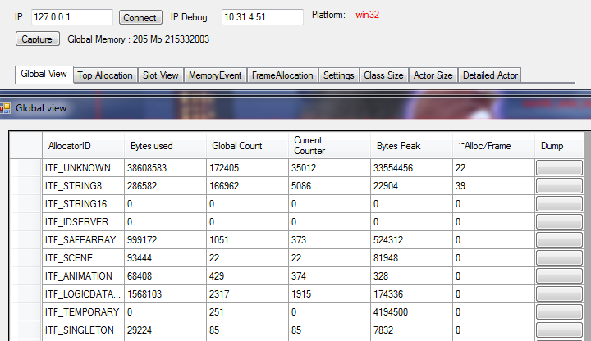
Memory viewer (tool)

Slide 5
Additional features
Memory leak tracking with call stack reporting

