Slide 1
Google test & google mock in JD
One Ring to rule them all
framework
tester

Slide 2
Concerning files
A new directory /unittests in /main (like /src)
For each project in /src, a project for test in /unittests
The class file and the test file have the same name.

Slide 3
Concerning Visual Studio
A test project for each engine project
Next to the engine projet itself, with the suffix Test
And a new application ua_unittests

Slide 4
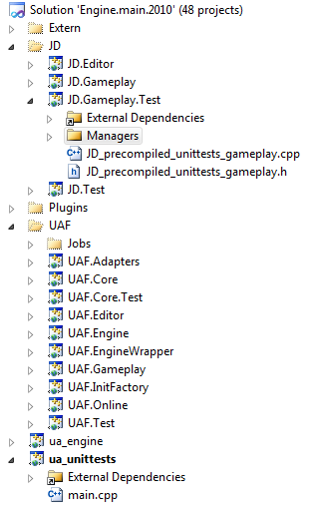
Concerning Visual Studio
Unit tests pour
JD.Gameplay
Unit tests pour
UAF.Core
Main application for
Unit tests

Slide 5
ua_unittests
A new application that executes unit tests.
Automatically launched by its own post-build (on PC).
Each time a compilation succeeds, unit tests are executed (PC).

Slide 6
Some constraints
To be able to access private members, the test has to be friend of the class,
With gtest, a test means a class.
So, we have to add in the class as many friend as we have tests.
Notes:
FRIEND_TEST() : dans gtest/gtest_prod.h

Slide 7
A solution
Create a unique class friend that provides accesses to private members.
It can be:
  An helper class
  The base class for test fixture.

